Slide 1
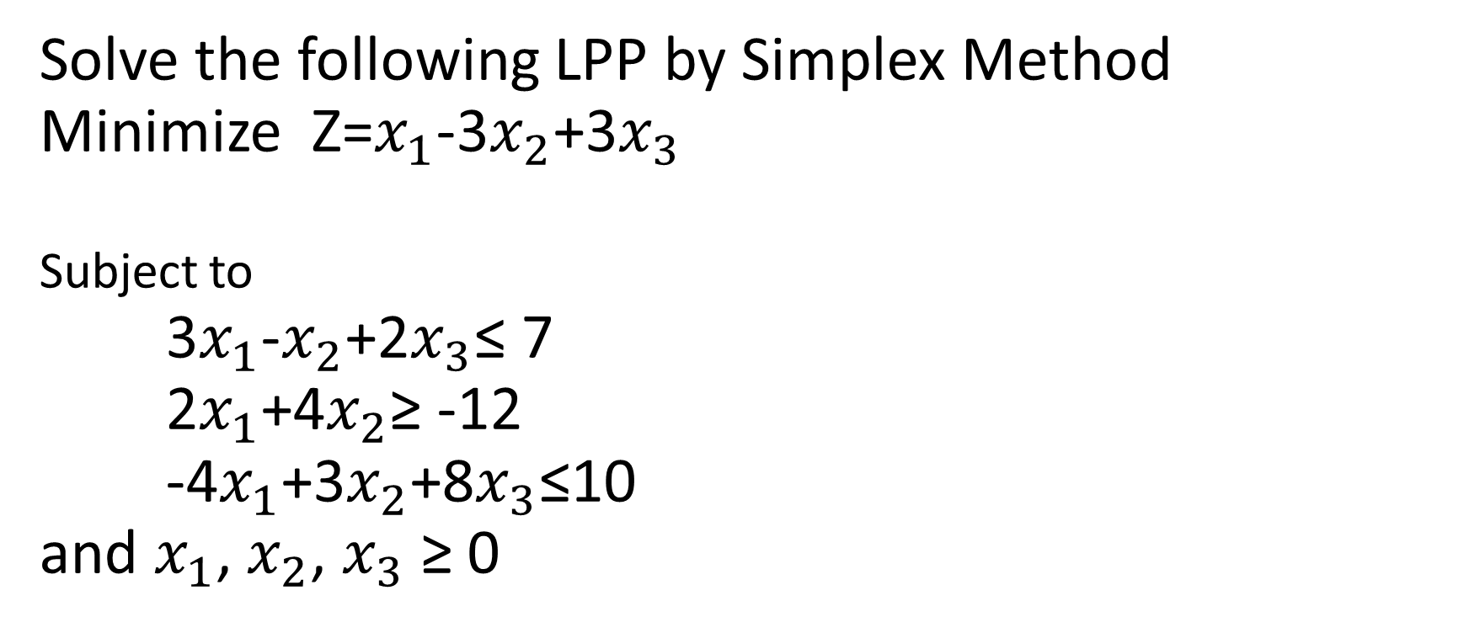
Example 3 (Simplex Method)
Solve the following LPP by Simplex Method
Minimize Z=$x_{1}$-3$x_{2}$+3$x_{3}$
Subject to
3$x_{1}$-$x_{2}$+2$x_{3}$≤ 7
2$x_{1}$+4$x_{2}$≥ -12
-4$x_{1}$+3$x_{2}$+8$x_{3}$≤10
and $x_{1}$, $x_{2}$, $x_{3}$ ≥ 0

Slide 2
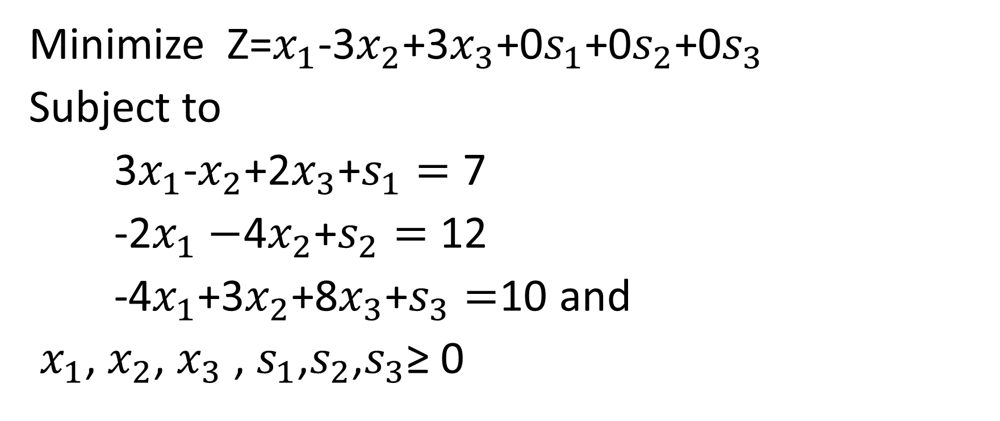
Standard Form of LPP
Minimize Z=$x_{1}$-3$x_{2}$+3$x_{3}$+0$s_{1}$+0$s_{2}$+0$s_{3}$
Subject to
3$x_{1}$-$x_{2}$+2$x_{3}$+$s_{1}=$ 7
-2$x_{1}−$4$x_{2}$+$s_{2}=$ 12
-4$x_{1}$+3$x_{2}$+8$x_{3}$+$s_{3}=$10 and
$x_{1}$, $x_{2}$, $x_{3}$ , $s_{1}$,$s_{2}$,$s_{3}$≥ 0

Slide 3
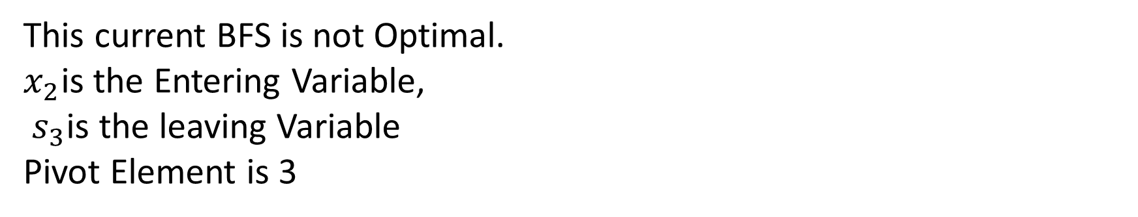
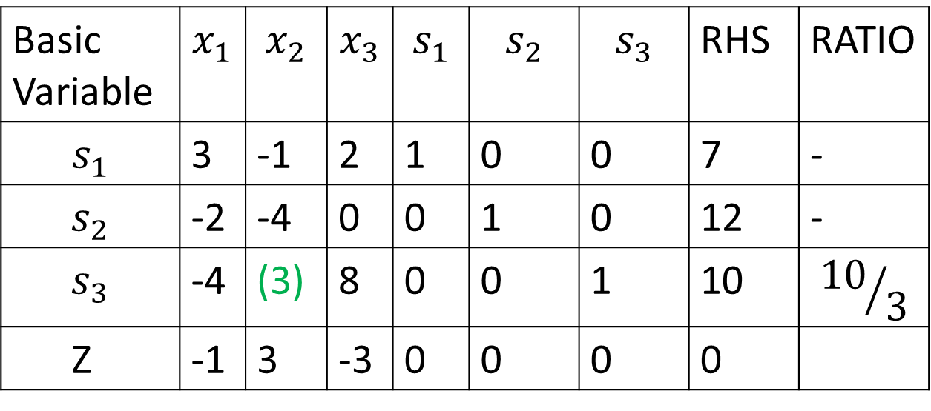
ITERATION 1
Basic Variable | $$x_{1}$$ | $$x_{2}$$ | $$x_{3}$$ | $$s_{1}$$ | $$s_{2}$$ | $$s_{3}$$ | RHS | RATIO
$$s_{1}$$ | 3 | -1 | 2 | 1 | 0 | 0 | 7 | -
$$s_{2}$$ | -2 | -4 | 0 | 0 | 1 | 0 | 12 | -
$$s_{3}$$ | -4 | (3) | 8 | 0 | 0 | 1 | 10 | $${10}/3$$
Z | -1 | 3 | -3 | 0 | 0 | 0 | 0
This current BFS is not Optimal.
$x_{2}$is the Entering Variable,
$s_{3}$is the leaving Variable
Pivot Element is 3

Slide 4
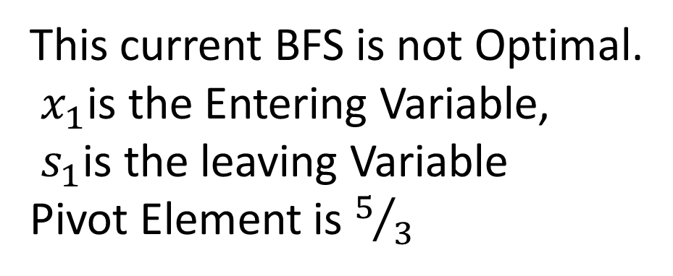
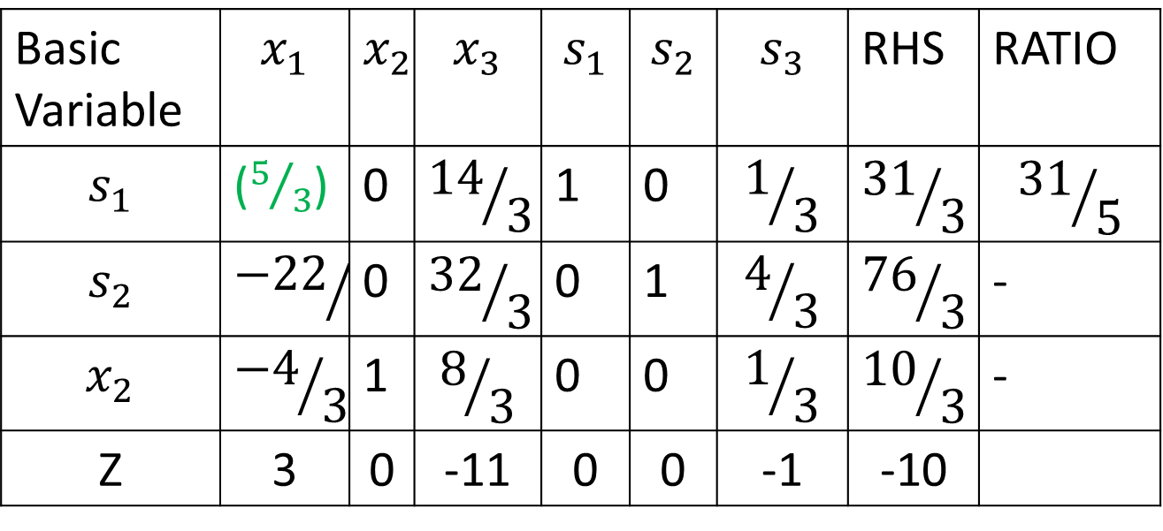
ITERATION 2
Basic Variable | $$x_{1}$$ | $$x_{2}$$ | $$x_{3}$$ | $$s_{1}$$ | $$s_{2}$$ | $$s_{3}$$ | RHS | RATIO
$$s_{1}$$ | ($5/3$) | 0 | $${14}/3$$ | 1 | 0 | $$1/3$$ | $${31}/3$$ | $${31}/5$$
$$s_{2}$$ | $${−22}/3$$ | 0 | $${32}/3$$ | 0 | 1 | $$4/3$$ | $${76}/3$$ | -
$$x_{2}$$ | $${−4}/3$$ | 1 | $$8/3$$ | 0 | 0 | $$1/3$$ | $${10}/3$$ | -
Z | 3 | 0 | -11 | 0 | 0 | -1 | -10
This current BFS is not Optimal.
$x_{1}$is the Entering Variable,
$s_{1}$is the leaving Variable
Pivot Element is $5/3$

Slide 5
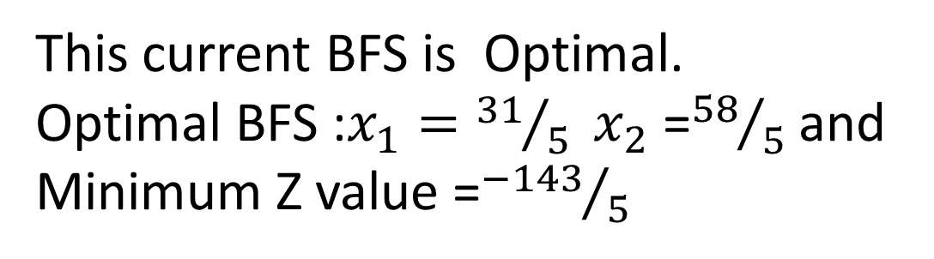
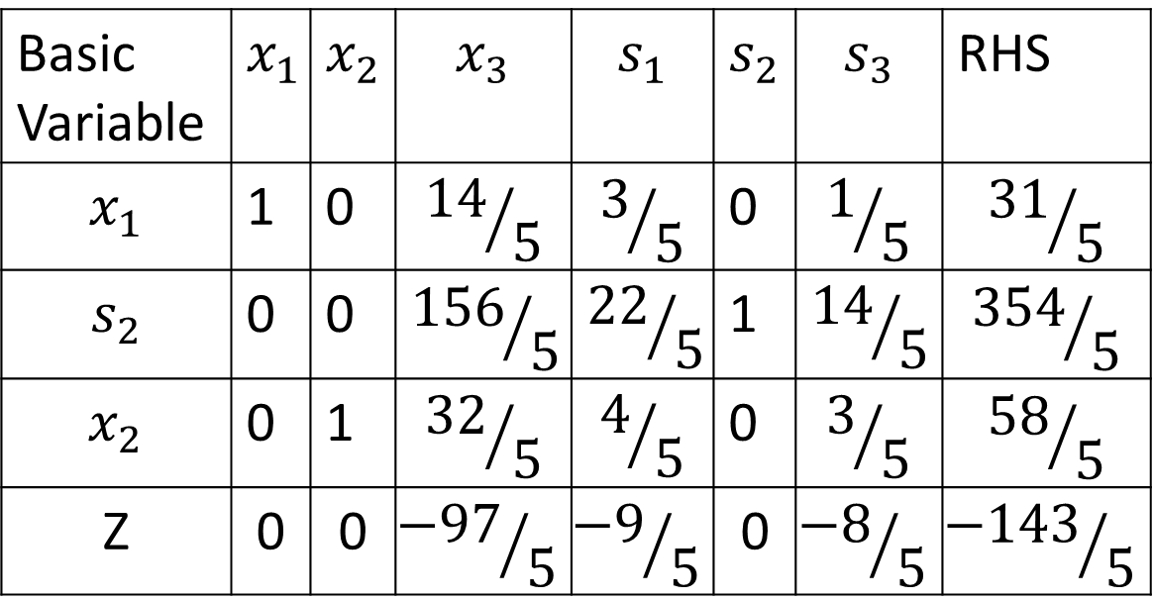
ITERATION 3
Basic Variable | $$x_{1}$$ | $$x_{2}$$ | $$x_{3}$$ | $$s_{1}$$ | $$s_{2}$$ | $$s_{3}$$ | RHS
$$x_{1}$$ | 1 | 0 | $${14}/5$$ | $$3/5$$ | 0 | $$1/5$$ | $${31}/5$$
$$s_{2}$$ | 0 | 0 | $${156}/5$$ | $${22}/5$$ | 1 | $${14}/5$$ | $${354}/5$$
$$x_{2}$$ | 0 | 1 | $${32}/5$$ | $$4/5$$ | 0 | $$3/5$$ | $${58}/5$$
Z | 0 | 0 | $${−97}/5$$ | $${−9}/5$$ | 0 | $${−8}/5$$ | $${−143}/5$$
This current BFS is Optimal.
Optimal BFS :$x_{1}={31}/5 x_{2}$ =${58}/5$ and
Minimum Z value =${−143}/5$

Slide 6
Introduction of Two-phase method
When a Initial basic feasible solution is not readily available, the two-phase simplex method may be used to solve the mixed constraints LPP
It is one of the method to solve a given LPP involving some artificial variables
This Method solves the LPP in Two Phases: Phase I attempts to find a starting BFS and if one is found, Phase II is invoked to solve the given problem

Slide 7
Phase I : In this phase, construct an auxiliary LPP leading to a optimal simplex table containing a Basic feasible solution to the given LPP.
Steps
Write the standard form of given LPP and then add artificial variables to the (≥)type and (=) type constraints.
Form the auxiliary LPP, the objective function is to minimize the sum of all artificial variables subject to constraints of given LPP.
Find a basic feasible solution to the given LPP by solving the auxiliary LPP.
i) If the objective function value of auxiliary LPP is zero and no artificial variable appears as basic variable in the Optimal Table, Go to Phase II.
ii) If auxiliary LPP objective function value is not equal to zero, the given LPP does not possess any feasible solution. STOP.

Slide 8
Two Phase Simplex Method
Remarks:
The removal of artificial variables and their column at the end of Phase I can take place only when they are all nonbasic. If one or more artificial variables are basic ( at zero level) at the end of Phase I, then the following additional steps must be under taken to remove them prior to start Phase II
Step 1. Select a zero artificial variable to leave the basic solution and designate its row as pivot row. The entering variable can be any nonbasic (non artificial) variable with nonzero (positive or negative) coefficient in the pivot row. Perform the associated simplex iteration.
Step 2. Remove the column of the (Just-leaving) artificial from the tableau. If all the zero artificial variables have been removed , go to Phase II.
Otherwise, go back to Step I.

Slide 9
Phase II
Steps
Take the Optimal simplex table of Phase I as a Initial Simplex table .
Replace the artificial objective function row (i.e.,r-row )by the given LPP objective function.
Apply simplex method to the modified simplex table to find the Optimal Basic Feasible Solution(if it exists)

Slide 10
Two Phase Simplex Method
Example 1
Minimize
Subject to:

Slide 11

Solution:
Phase I: AUXIALIARY LPP
Minimize:
Subject to:
Here $R_{1}$and $R_{2}$are the artificial variables and $x_{4}$is the slack variable, $x_{3}$is the surplus variable

Slide 12
Iteration 1
RHS | x₄ | R₂ | R₁ | x₃ | x₂ | x₁ | Basic variable
3 | 0 | 0 | 1 | 0 | 1 | 3 | R₁
6 | 0 | 1 | 0 | -1 | 3 | 4 | R₂
4 | 1 | 0 | 0 | 0 | 2 | 1 | x4
9 | 0 | -1 | -1 | 0 | 0 | 0 | r
New r-row = Old r-row + 1* R₁-row + 1*R₂ -row
RHS | x₄ | R₂ | R₁ | x₃ | x₂ | x₁ | Basic variable
3 | 0 | 0 | 1 | 0 | 1 | 3 | R₁
6 | 0 | 1 | 0 | -1 | 3 | 4 | R₂
4 | 1 | 0 | 0 | 0 | 2 | 1 | x4
9 | 0 | 0 | 0 | -1 | 4 | 7 | r

Slide 13
By using new r-row, we solve Phase I of the problem which yields the following optimum tableau
RHS | x₄ | R₂ | R₁ | x₃ | x₂ | x₁ | Basic variable
3/5 | 0 | -1/5 | 3/5 | 1/5 | 0 | 1 | x₁
6/5 | 0 | 3/5 | -4/5 | -3/5 | 1 | 0 | x₂
1 | 1 | -1 | 1 | 1 | 0 | 0 | x4
0 | 0 | -1 | -1 | 0 | 0 | 0 | r
Because minimum r=0, Phase I produces the basic feasible solution:

Slide 14
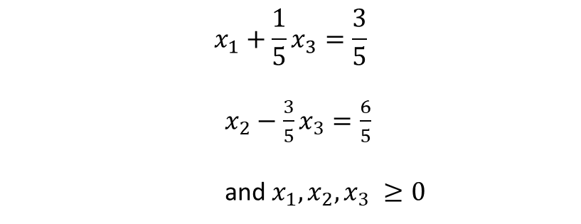
Phase II
After eliminating artificial variables column, the original problem can be written as:
Minimize:
Subject to:
$$x_{1}+\frac{1}{5}x_{3}=\frac{3}{5}$$
$x_{2}−\frac{3}{5}x_{3}=\frac{6}{5}$
and $x_{1}, x_{2}, x_{3} ≥0$

Slide 15
RHS | x₄ | x₃ | x₂ | x₁ | Basic variable
3/5 | 0 | 1/5 | 0 | 1 | x₁
6/5 | 0 | -3/5 | 1 | 0 | x₂
1 | 1 | 1 | 0 | 0 | x4
0 | 0 | 0 | -1 | -4 | z
Again, because basic variables x₁ and x₂ have nonzero coefficient in the z row, they must be substituted out, using the following computation:
New z-row = Old z-row + 4* x₁-row + 1*x₂ -row

Slide 16
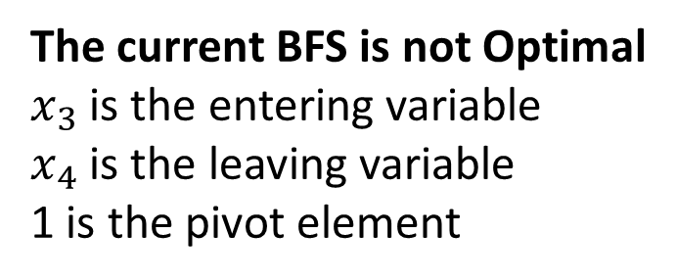
Phase II
The initial tableau of Phase II is as the following:
RHS | x₄ | x₃ | x₂ | x₁ | Basic variable
3/5 | 0 | 1/5 | 0 | 1 | x₁
6/5 | 0 | -3/5 | 1 | 0 | x₂
1 | 1 | 1 | 0 | 0 | x4
18/5 | 0 | 1/5 | 0 | 0 | z
The current BFS is not Optimal
$x_{3}$ is the entering variable
$x_{4}$ is the leaving variable
1 is the pivot element

Slide 17
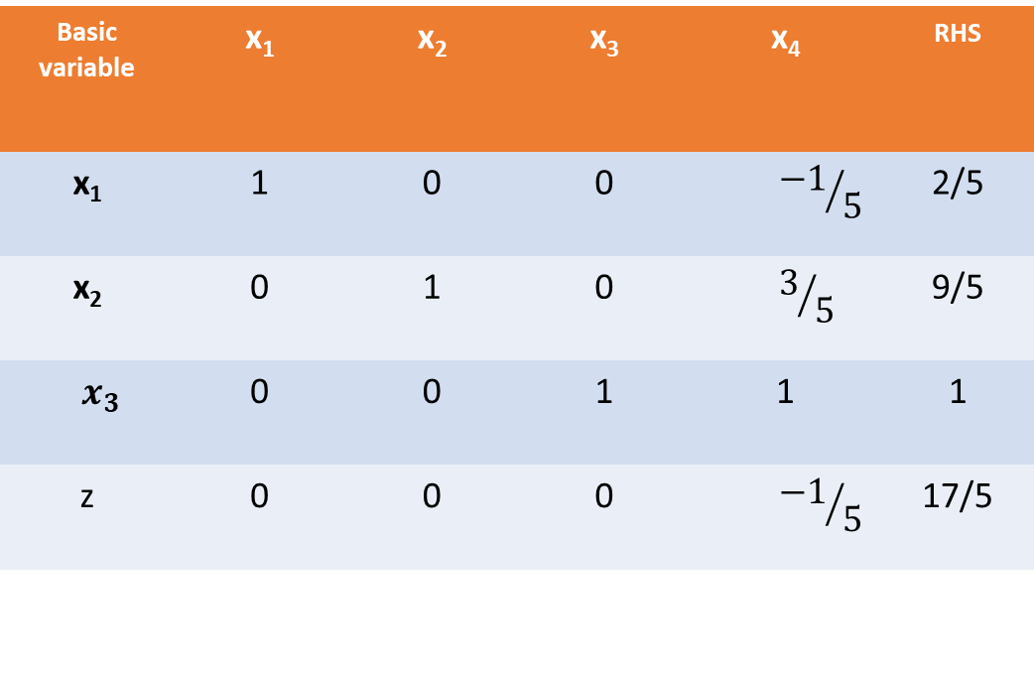
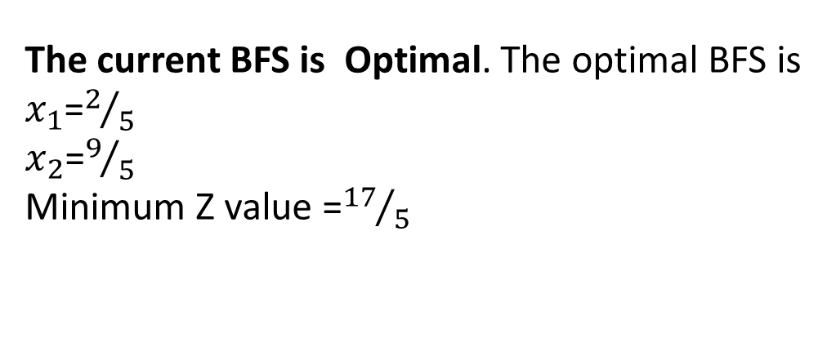
Phase II
Iteration 2:
RHS | x₄ | x₃ | x₂ | x₁ | Basic variable
2/5 | $${−1}/5$$ | 0 | 0 | 1 | x₁
9/5 | $$3/5$$ | 0 | 1 | 0 | x₂
1 | 1 | 1 | 0 | 0 | $$x_{3}$$
17/5 | $${−1}/5$$ | 0 | 0 | 0 | z
The current BFS is Optimal. The optimal BFS is
$x_{1}$=$2/5$
$x_{2}$=$9/5$
Minimum Z value =${17}/5$

Slide 18

Example 2 (Two Phase Simplex Method)
Solve the following LPP:
Maximize Z=3$x_{1}$+2$x_{2}$+3$x_{3}$
Subject to
2$x_{1}$+$x_{2}$+$x_{3}$≤ 2
3$x_{1}$+4$x_{2}$+2$x_{3}$≥ 8 and $x_{1,}x_{2,}x_{3}$≥ 0

Slide 19

Phase I
Auxiliary LPP
Minimise r=R
Subject to
2$x_{1}$+$x_{2}$+$x_{3}$+$x_{5}$= 2
3$x_{1}$+4$x_{2}$+2$x_{3}$-$x_{4}$+R = 8 and $x_{1,}x_{2,}x_{3,}x_{4,}x_{5,}$ R ≥ 0

Slide 20
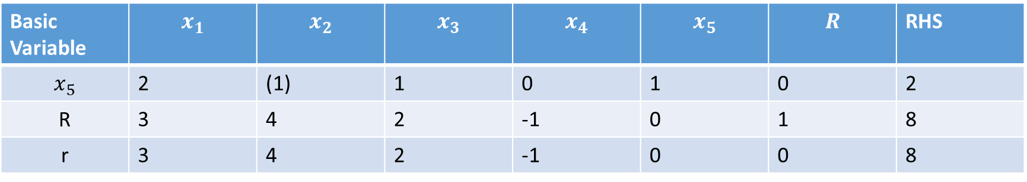
Phase I Iteration 1
Basic Variable | $$x_{1}$$ | $$x_{2}$$ | $$x_{3}$$ | $$x_{4}$$ | $$x_{5}$$ | $$R$$ | RHS
$$x_{5}$$ | 2 | (1) | 1 | 0 | 1 | 0 | 2
R | 3 | 4 | 2 | -1 | 0 | 1 | 8
r | 3 | 4 | 2 | -1 | 0 | 0 | 8

Slide 21
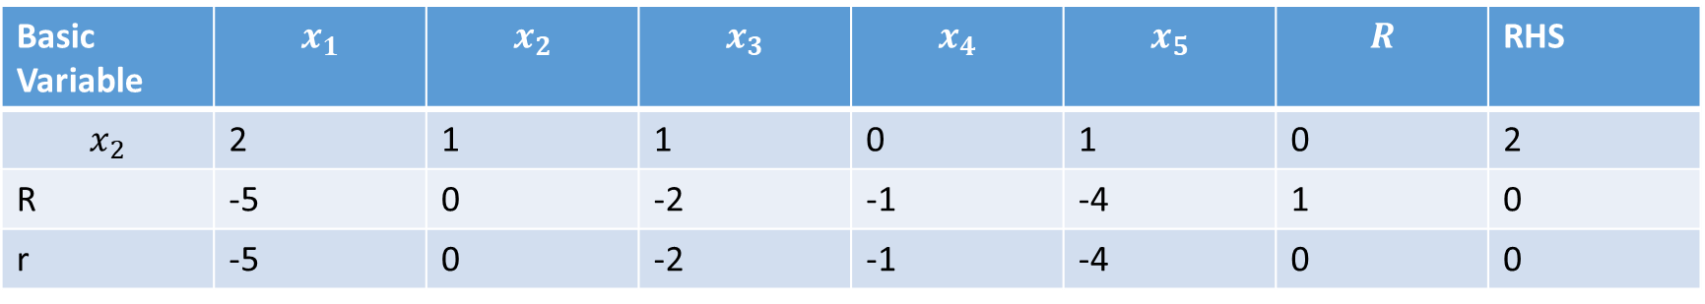
Phase I Iteration 2
Basic Variable | $$x_{1}$$ | $$x_{2}$$ | $$x_{3}$$ | $$x_{4}$$ | $$x_{5}$$ | $$R$$ | RHS
$$x_{2}$$ | 2 | 1 | 1 | 0 | 1 | 0 | 2
R | -5 | 0 | -2 | -1 | -4 | 1 | 0
r | -5 | 0 | -2 | -1 | -4 | 0 | 0
Since r=0 and artificial variable R appears in the Phase I Optimal table at zero level, Go to Phase II

Slide 22
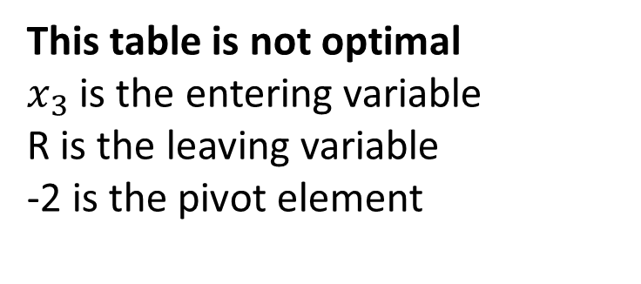
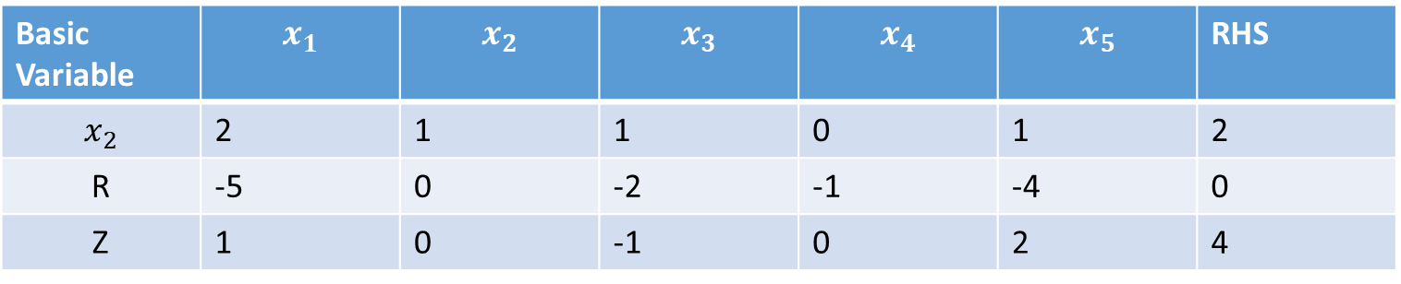
Phase II Iteration 1(Replace the last row in the Optimal table of Phase I by given LPP Objective function)
Basic Variable | $$x_{1}$$ | $$x_{2}$$ | $$x_{3}$$ | $$x_{4}$$ | $$x_{5}$$ | RHS
$$x_{2}$$ | 2 | 1 | 1 | 0 | 1 | 2
R | -5 | 0 | -2 | -1 | -4 | 0
Z | 1 | 0 | -1 | 0 | 2 | 4
This table is not optimal
$x_{3}$ is the entering variable
R is the leaving variable
-2 is the pivot element

Slide 23
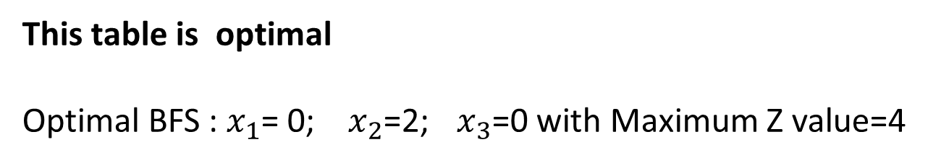
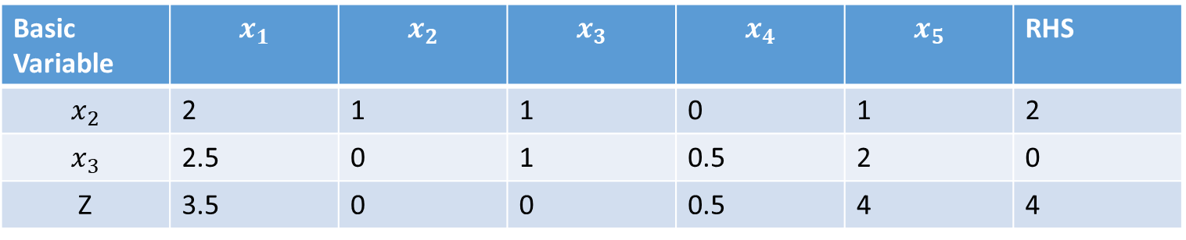
Phase II Iteration 2
Basic Variable | $$x_{1}$$ | $$x_{2}$$ | $$x_{3}$$ | $$x_{4}$$ | $$x_{5}$$ | RHS
$$x_{2}$$ | 2 | 1 | 1 | 0 | 1 | 2
$$x_{3}$$ | 2.5 | 0 | 1 | 0.5 | 2 | 0
Z | 3.5 | 0 | 0 | 0.5 | 4 | 4
This table is optimal
Optimal BFS : $x_{1}$= 0; $x_{2}$=2; $x_{3}$=0 with Maximum Z value=4

Slide 24
NOTES FOR SIMPLEX TABLE
If there is a zero under one or more nonbasic variables in the last tableau (optimal solution tableau), then there is a multiple optimal solution.
2. When determining the leaving variable of any tableau, if there is no positive ratio (all the entries in the pivot column are negative and zeroes), then the solution is unbounded.
3. If there is a tie in determining the leaving variable, choose any one to be the leaving variable. In this case a zero will appear in RHS column; therefore, a “cycle” will occur, this means that the value of the objective function will be the same for several iterations.
4. A Solution that has a basic variable with zero value is called a “degenerate solution”.
5. If there is no Artificial variables in the problem, there is no room for “infeasible solution”

Slide 25

Example (Degenerate Optimal Solution)
Maximize Z = 3$x_{1}$+9$x_{2}$
Subject to
$x_{1}$+4$x_{2}$≤ 8
$x_{1}$+2$x_{2}$≤ 4 and $x_{1}$, $x_{2}$≥ 0

Slide 26

Example (Infinite Number of Solutions)
Maximize Z=2$x_{1}$+4$x_{2}$
Subject to
$x_{1}$+2$x_{2}$≤ 5
$x_{1}$+$x_{2}≤4$ and $x_{1}$,$x_{2}$≥ 0

Slide 27

Example (Unbounded Solution)
Maximize Z= 2$x_{1}$+$x_{2}$
Subject to
$x_{1}$-$x_{2}$≤ 10
2$x_{1}$≤ 40 and $x_{1}$, $x_{2}$≥ 0

Slide 28

Example (Infeasible Solution)
Maximize Z= 3$x_{1}$+2$x_{2}$
Subject to
2$x_{1}$+$x_{2}$≤ 2
3$x_{1}$+4$x_{2}$≥ 12 and $x_{1}$, $x_{2}$≥ 0

Slide 29
THANK YOU

